Slide 1
Cloud Computing

Slide 2
agenda
Introduction
Cloud-Need of Today
Cloud Providers
Azure-Operations
Final tips & takeaways

Slide 3

Introduction to Cloud Computing Cloud computing is the delivery of computing services—like servers, storage, databases, networking, software, and more—over the internet ("the cloud"). Instead of owning and maintaining physical servers, you access these resources via cloud providers such as: 1. Microsoft Azure 2.Amazon Web Services (AWS) 3.Google Cloud Platform (GCP)

Slide 4
Why Cloud is Needed Today
1. Cost Efficiency
No need to buy and maintain expensive hardware. Pay only for what you use.
2. Scalability
Easily scale your applications up or down depending on demand.
3. Remote Accessibility
Work from anywhere with internet access. Great for remote teams.
4. Disaster Recovery
Cloud providers offer backup and disaster recovery options for business continuity.
5. Security
Leading cloud providers offer built-in security features like encryption, identity management, and compliance support.

Slide 5

Cloud Service Providers
Popular choices include:
AWS (Amazon Web Services)
Microsoft Azure
Google Cloud Platform (GCP)

Slide 6
Azure
Virtual Network Creation

Slide 7
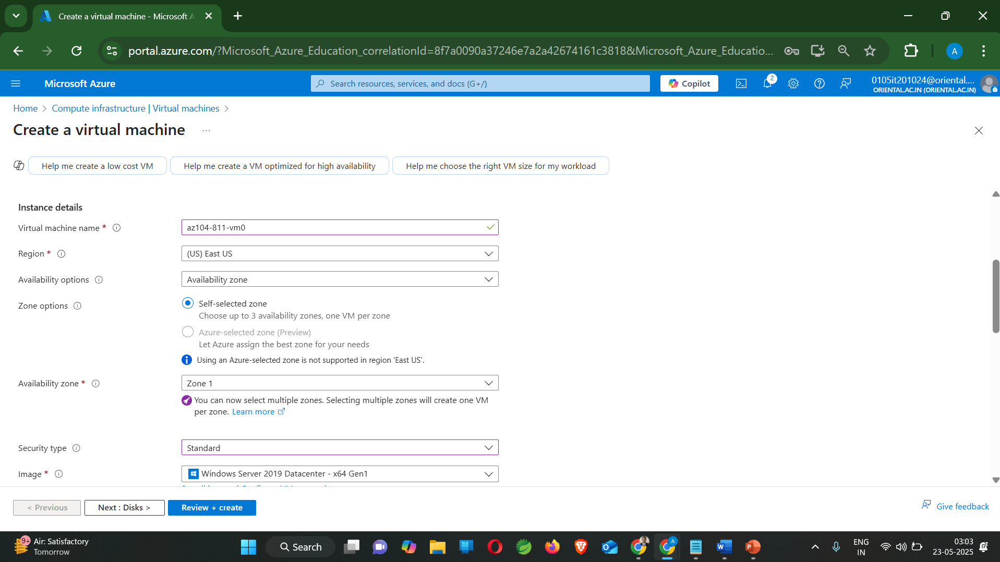
Effective delivery techniques
This is a powerful tool in public speaking. It involves varying pitch, tone, and volume to convey emotion, emphasize points, and maintain interest.
Pitch variation
Tone inflection
Volume control
Effective body language enhances your message, making it more impactful and memorable.
Meaningful eye contact
Purposeful gestures
Maintain good posture
Control your expressions

Slide 8
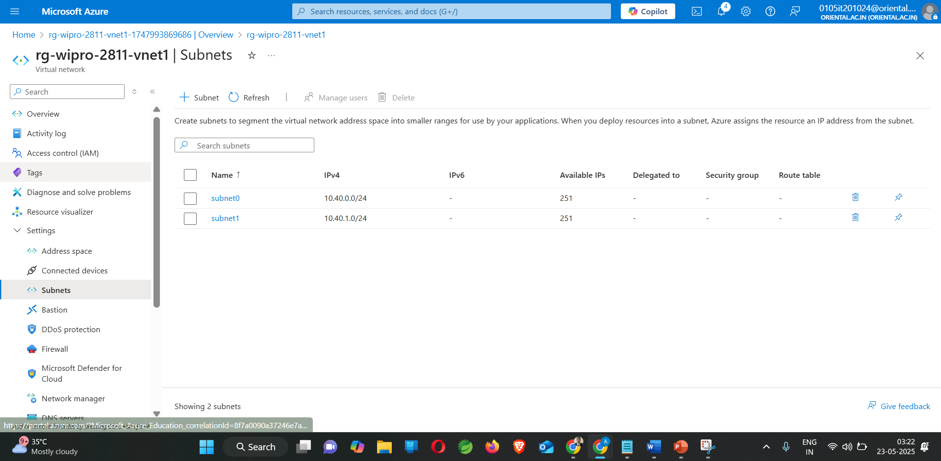

Navigating Q&A sessions
Maintaining composure during the Q&A session is essential for projecting confidence and authority. Consider the following tips for staying composed:
Stay calm
Actively listen
Pause and reflect
Maintain eye contact
Know your material in advance
Anticipate common questions
Rehearse your responses

Slide 9
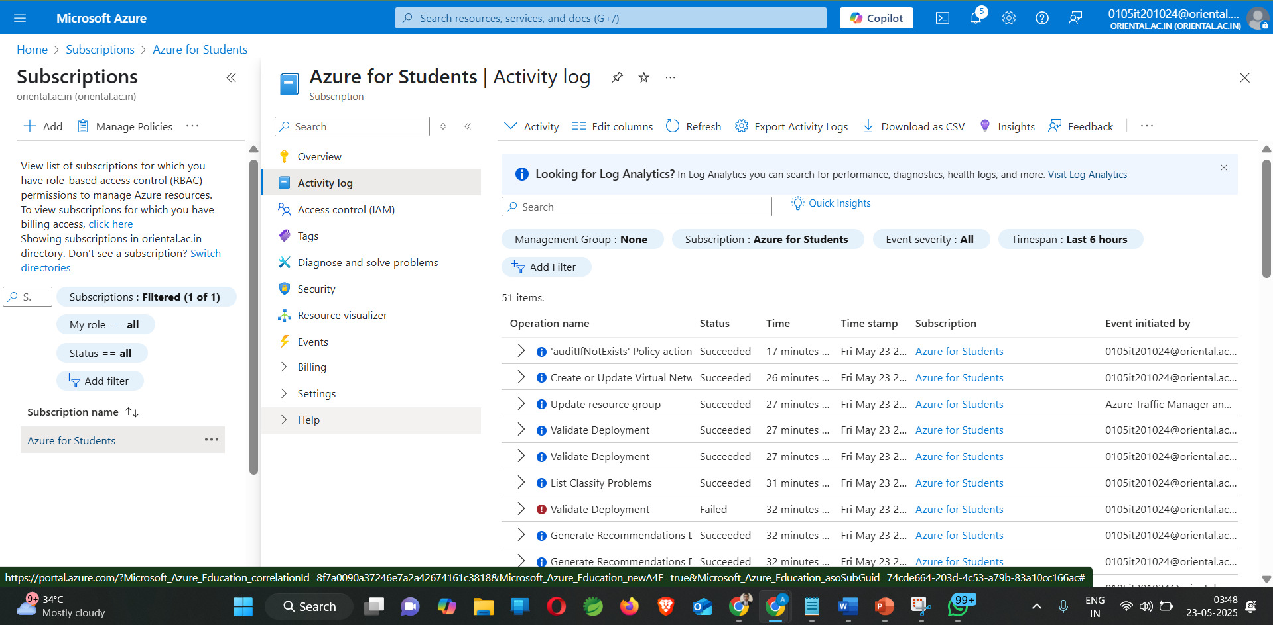
Dynamic delivery
Learn to infuse energy into your delivery to leave a lasting impression
One of the goals of effective communication is to motivate your audience
Metric | Measurement | Target | Actual
Audience attendance | # of attendees | 150 | 120
Engagement duration | Minutes | 60 | 75
Q&A interaction | # of questions | 10 | 15
Positive feedback | Percentage (%) | 90 | 95
Rate of information retention | Percentage (%) | 80 | 85

Slide 10
Thank you
28811-Anuj Sen

